Slide 1
Clustering

Slide 2
Learnings
Supervised Learning
Unsupervised Learning

Slide 3
Clustering:
1.It is the grouping of data that have similar characteristics.
2.It helps segment data into groups and analyze each to find patterns.
Example: Clustering algorithms identify groups of users basedontheir online purchasing history and then send each member targetedads.

Slide 4
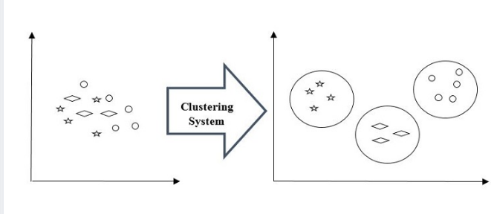

Slide 5
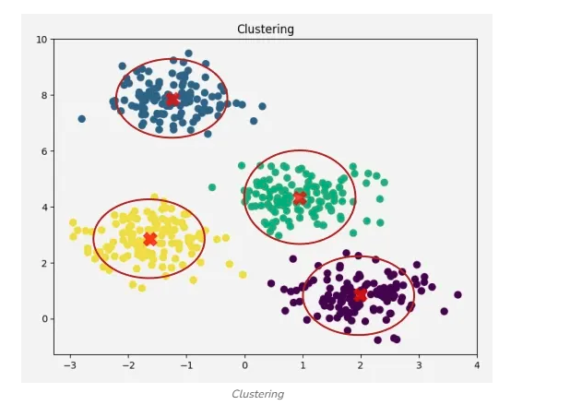

Slide 6
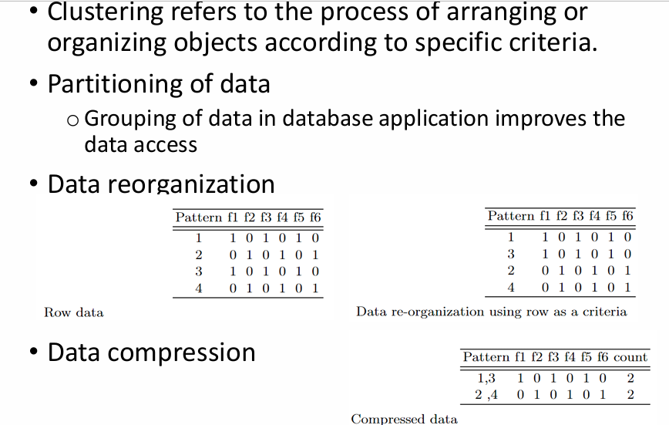
Clustering

Slide 7
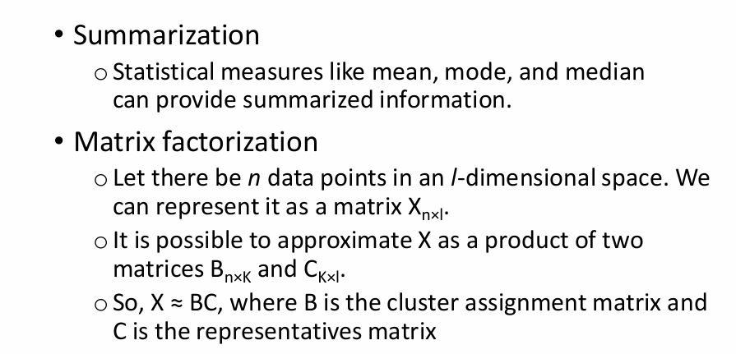

Slide 8
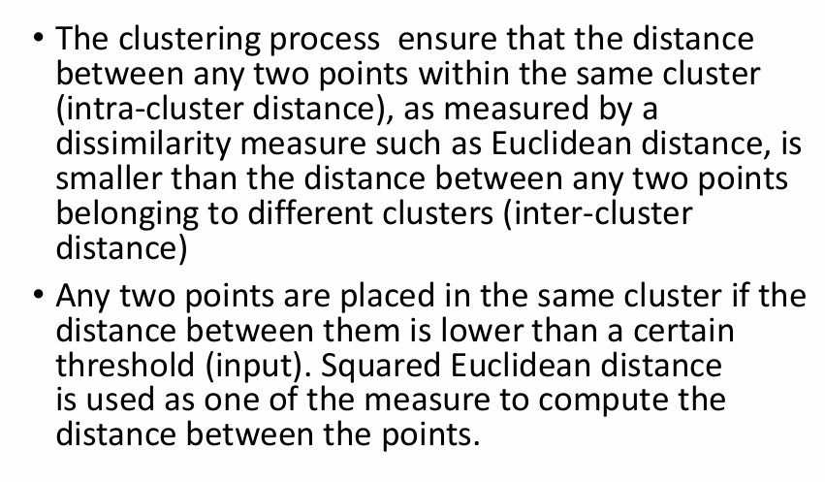
Clustering process

Slide 9

Clustering
Number of clusters
Centroids-Mean/avg Point
Mediods-A medoid is the most centrally located actual data point in a cluster.
Points: (2,4), (4,6), (100,200)
Centroid → affected by (100,200) (shifts far)
Medoid → likely (4,6) (more stable)

Slide 10
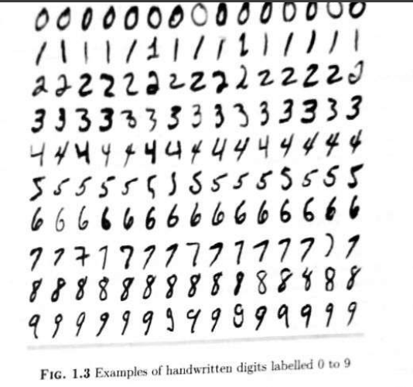
Clustering

Slide 11
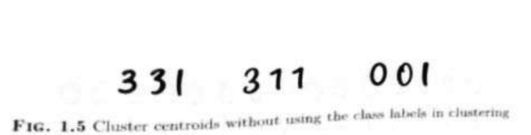
Clustering-Clusters,centroids
9-clusters

Slide 12
Types of Clustering
1. Hard Clustering
Hard clustering assigns each data point to exactly one cluster. A data point cannot belong to multiple clusters, making the grouping clear and easy to interpret.
Each data point belongs to only one cluster
No overlap between clusters
Simple and easy to interpret
Example
If customers are divided into two clusters, each customer belongs completely to either Cluster 1 or Cluster 2. A customer cannot belong to both clusters at the same time.

Slide 13
2. Soft Clustering
Soft clustering allows a data point to belong to multiple clusters with different probabilities. Instead of assigning a strict cluster, it gives a degree of membership to each cluster.
Example
A data point may belong 70% to Cluster 1 and 30% to Cluster 2, indicating that it shares characteristics with both groups.

Slide 14
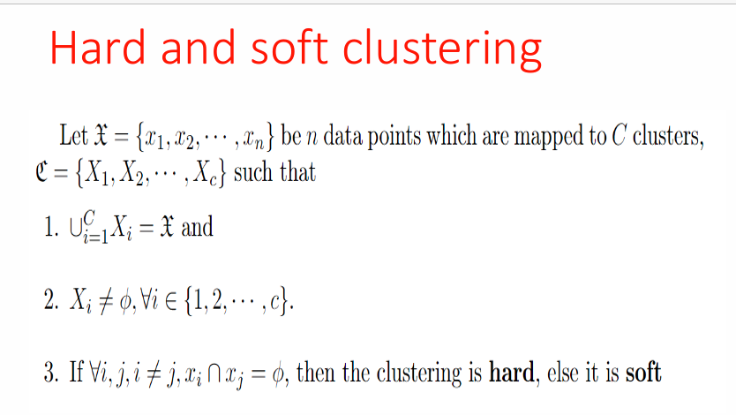
Hard and Soft Clustering

Slide 15
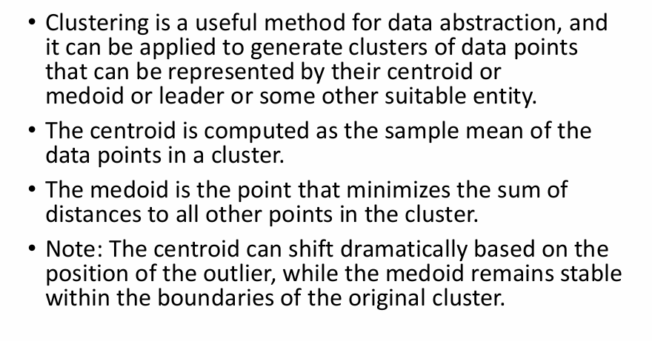
Data abstraction

Slide 16
Clustering of patterns
Clustering of patterns means grouping similar patterns (data points) together so that:
Patterns in the same cluster are similar
Patterns in different clusters are dissimila
A pattern is a set of features describing an object.
Automatically organizing patterns into groups based on similarity
No predefined labels are given.

Slide 17
Steps in Pattern Clustering
Feature Selection
  Choose important attributes (e.g., height, weight)
Similarity Measurement
  Use distance measures:
    Euclidean distance
    Manhattan distance
Apply Clustering Algorithm
  K-Means
  Hierarchical clustering
  DBSCAN
Form Clusters
  Group similar patterns together

Slide 18
Types of Pattern Clustering
1. Hard Clustering
Each pattern belongs to only one cluster
Example: K-Means
2. Soft Clustering
A pattern can belong to multiple clusters with probability
Example: Fuzzy C-Means

Slide 19
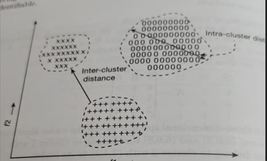
Clustering of Patterns

Slide 20

Squared Euclidiean Distance

Slide 21

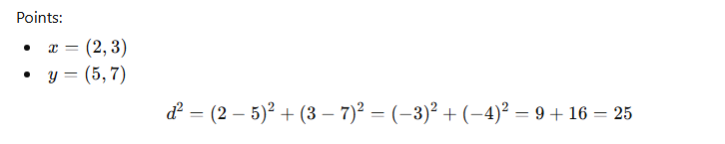

Slide 22
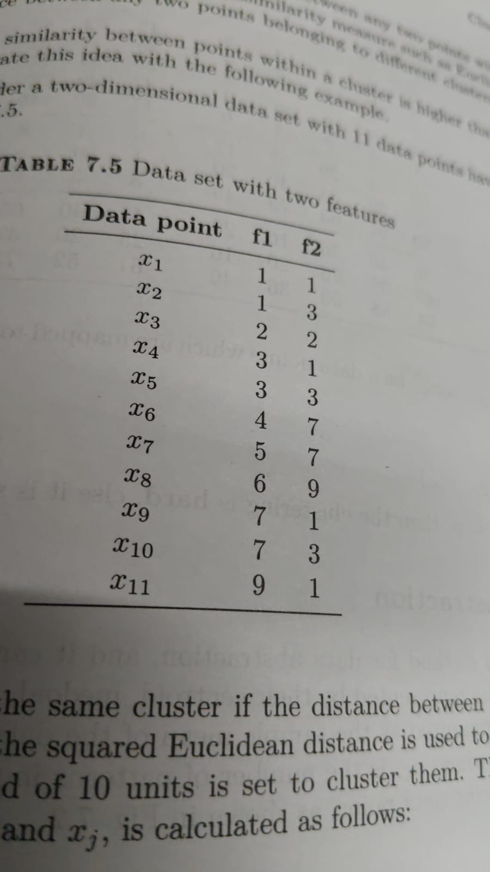
Data set 11 instances and Two features F1 F2

Slide 23
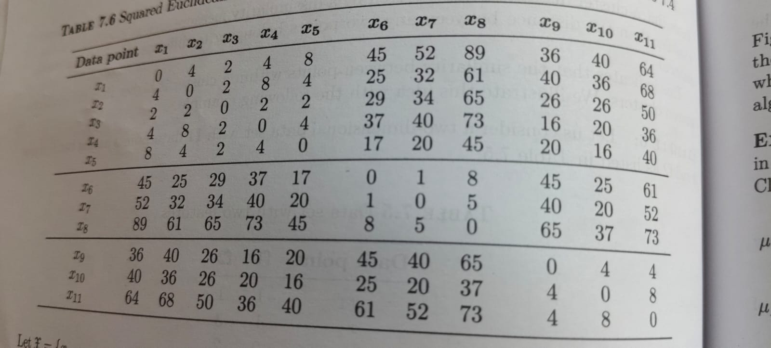

Slide 24
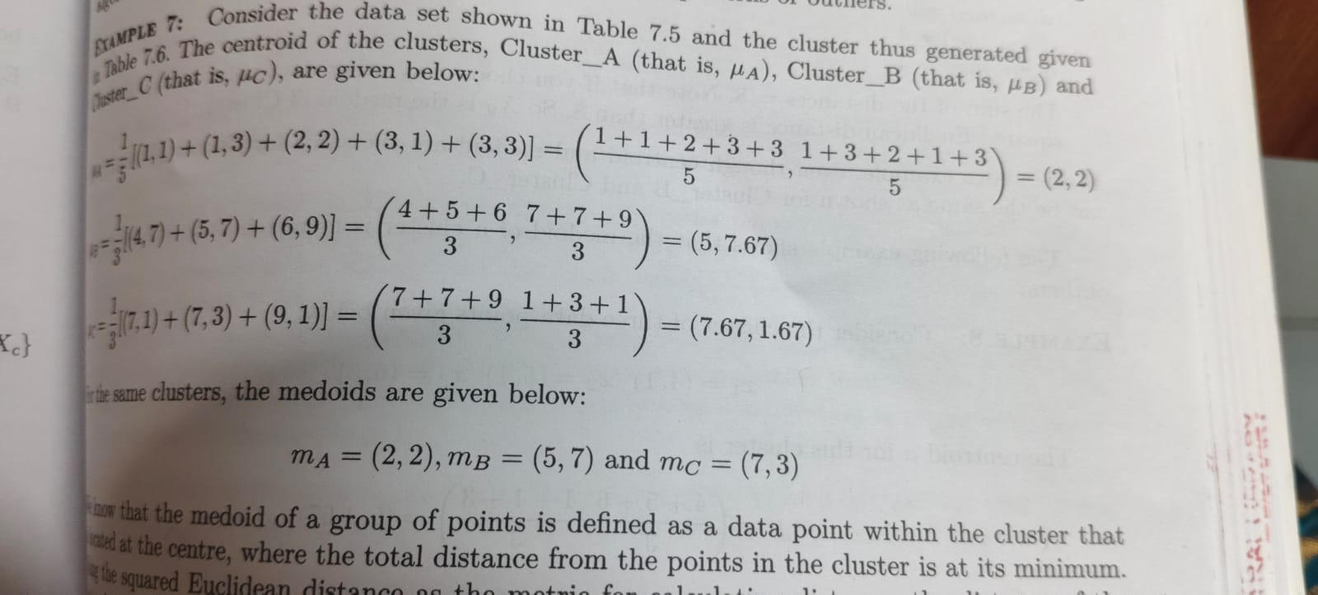
Three Clusters-Centroids and Meloids

Slide 25
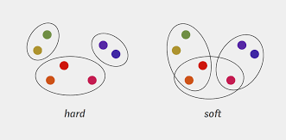
Clustering Algorithms-Hard/Soft

Slide 26
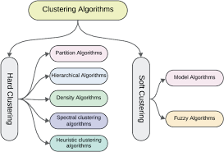
Clustering algorithms

Slide 27
Divisive Clustering
Divisive Clustering is a type of hierarchical clustering that follows a top-down approach. It starts by placing all data points into one large cluster and then recursively splits that cluster into smaller ones based on differences or distances between the points.
This process continues until each cluster contains only similar data points or meets a stopping condition. It is the opposite of agglomerative clustering, which builds clusters from the bottom up. It is is useful when we want to break down a broad category into smaller, meaningful groups.

Slide 28
Workflow of Divisive Clustering
Start with all data points: Begin with one big group ABCDEFGH.
First split: Divide it into two groups ABC and DEFGH.
Split again: The group ABC is divided into A and BC while the group DEFGH is split into DEFG and H.
Keep dividing: We continue dividing these new groups. BC is split into B and C, DEFG is divided into DE and so on. At this stage most of the data points are now in their individual groups.
Finish: Stop when all points are separated.

Slide 29
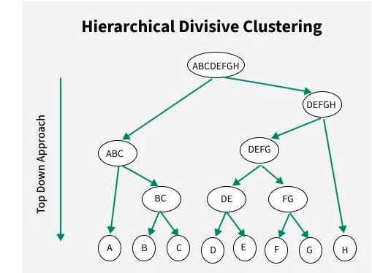
Divisive Clustering

Slide 30
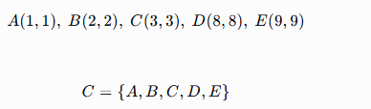

Slide 31
 | A | B | C | D | E
A | 0 | 1.414 | 2.828 | 9.899 | 11.314
B | 1.414 | 0 | 1.414 | 8.485 | 9.899
C | 2.828 | 1.414 | 0 | 7.071 | 8.485
D | 9.899 | 8.485 | 7.071 | 0 | 1.414
E | 11.314 | 9.899 | 8.485 | 1.414 | 0

Slide 32
First Split
A, B, C are close together.
D, E are close together.
The distance between these two groups is large.

Slide 33
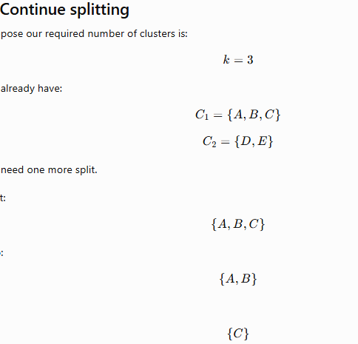

Slide 34
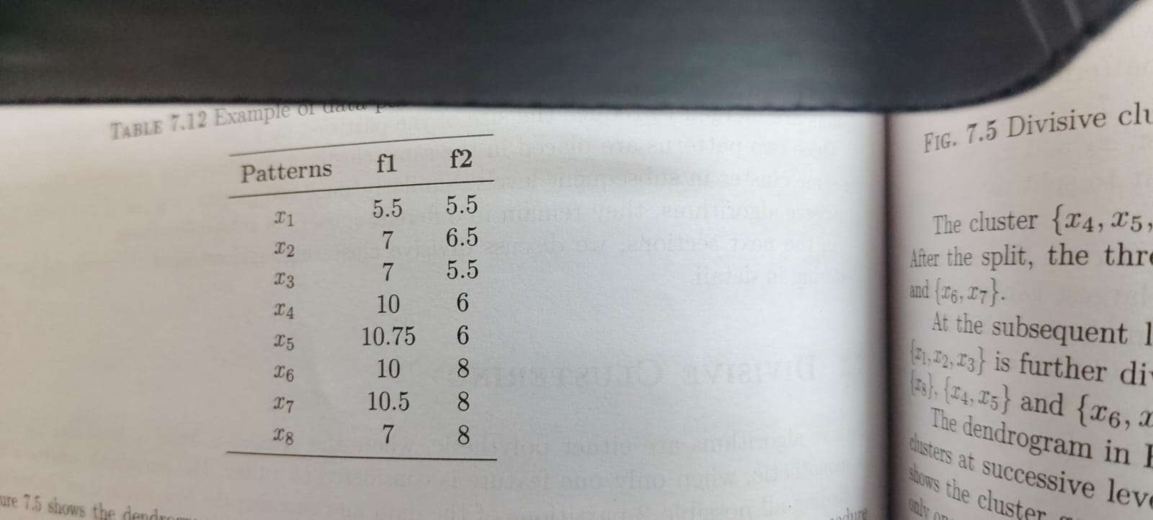

Slide 35
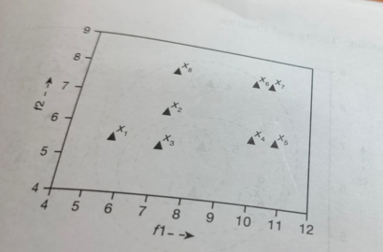

Slide 36
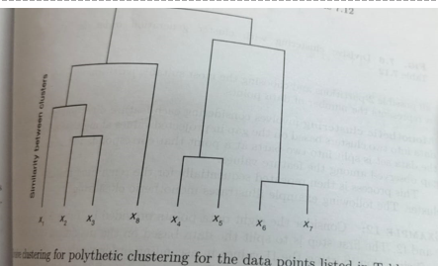

Slide 37
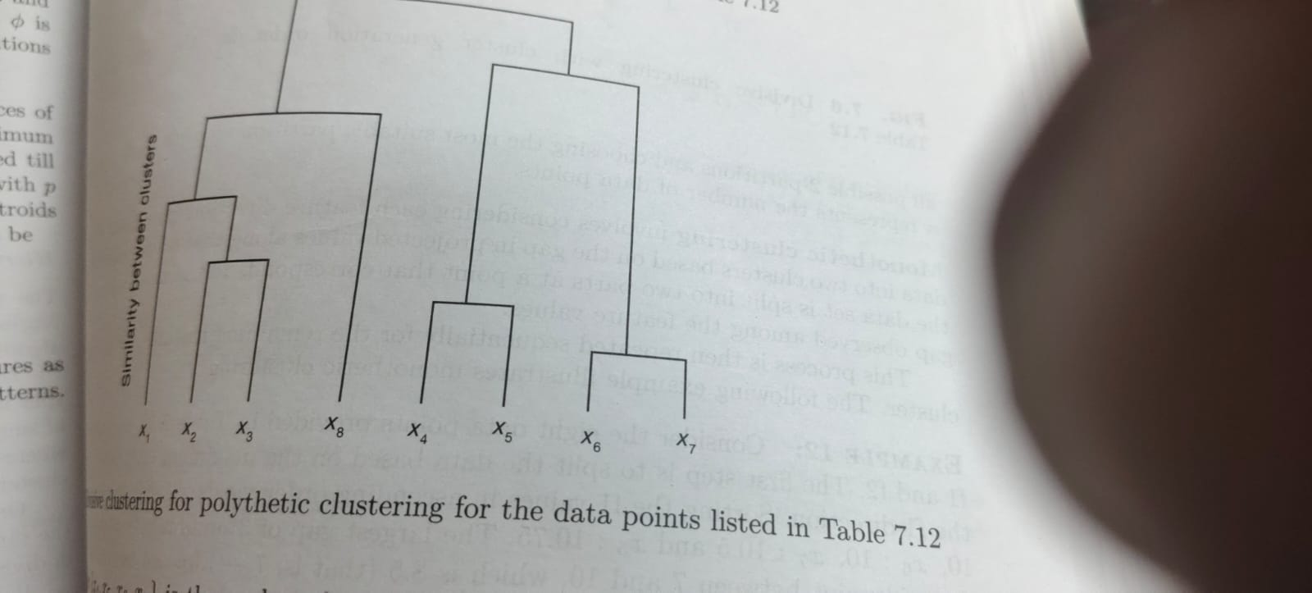

Slide 38
Agglomerative Clustering
To group similar data points into clusters based on their proximity, Agglomerative Clustering is used which is a type of hierarchical clustering. It follows a bottom-up approach, where each data point starts as its own cluster and gradually merges with others based on similarity.
The merging continues until all points form a single cluster or a set number of clusters remain.
It uses distance metrics like Euclidean or Manhattan distance to measure similarity.
The process is often visualized using a dendrogram, which shows the hierarchy of cluster formation.
Common linkage methods include single, complete, average and ward linkage.

Slide 39
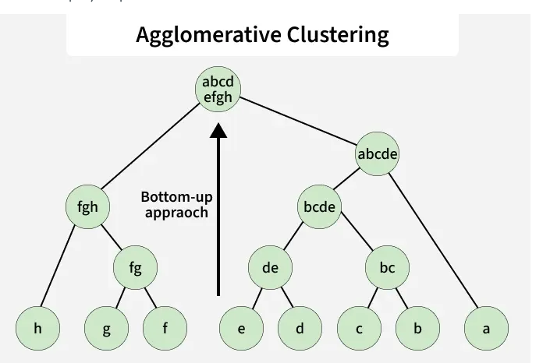
v

Slide 40
1. Start with all points separate:
Treat each data point as its own cluster like A, B, C, ...
Initially, you have n clusters for n data points.
2. Compute pairwise distances:
Calculate the distance between every pair of clusters.
Common choices include Euclidean, Manhattan or Cosine distance.
Store these values in a distance matrix.

Slide 41
3. Merge the nearest clusters:
Identify the two clusters that are closest based on the chosen linkage method such as single, complete, average or Ward linkage.
Combine them into a single new cluster.
4. Update distances:
Recalculate the distances between the newly formed cluster and all remaining clusters.
Use the same linkage rule to ensure consistency.
5. Repeat the process:
Continue merging clusters and updating distances iteratively.
Stop when you reach a predefined number of clusters (k) or a distance threshold

